Slide 1





Automated Visiting Card Information Extraction
Team Members
Guide
1. Shivam Deoliya
2. Pranjal Sharma
Karan Bhat

Slide 2
Disclaimer
The content is curated from online/offline resources and used for educational purpose only

Slide 3

Course Outline
Problem Statement
Proposed Solution
Software Requirement
System Architecture
Demo Video
Future Scope
Conclusion

Slide 4

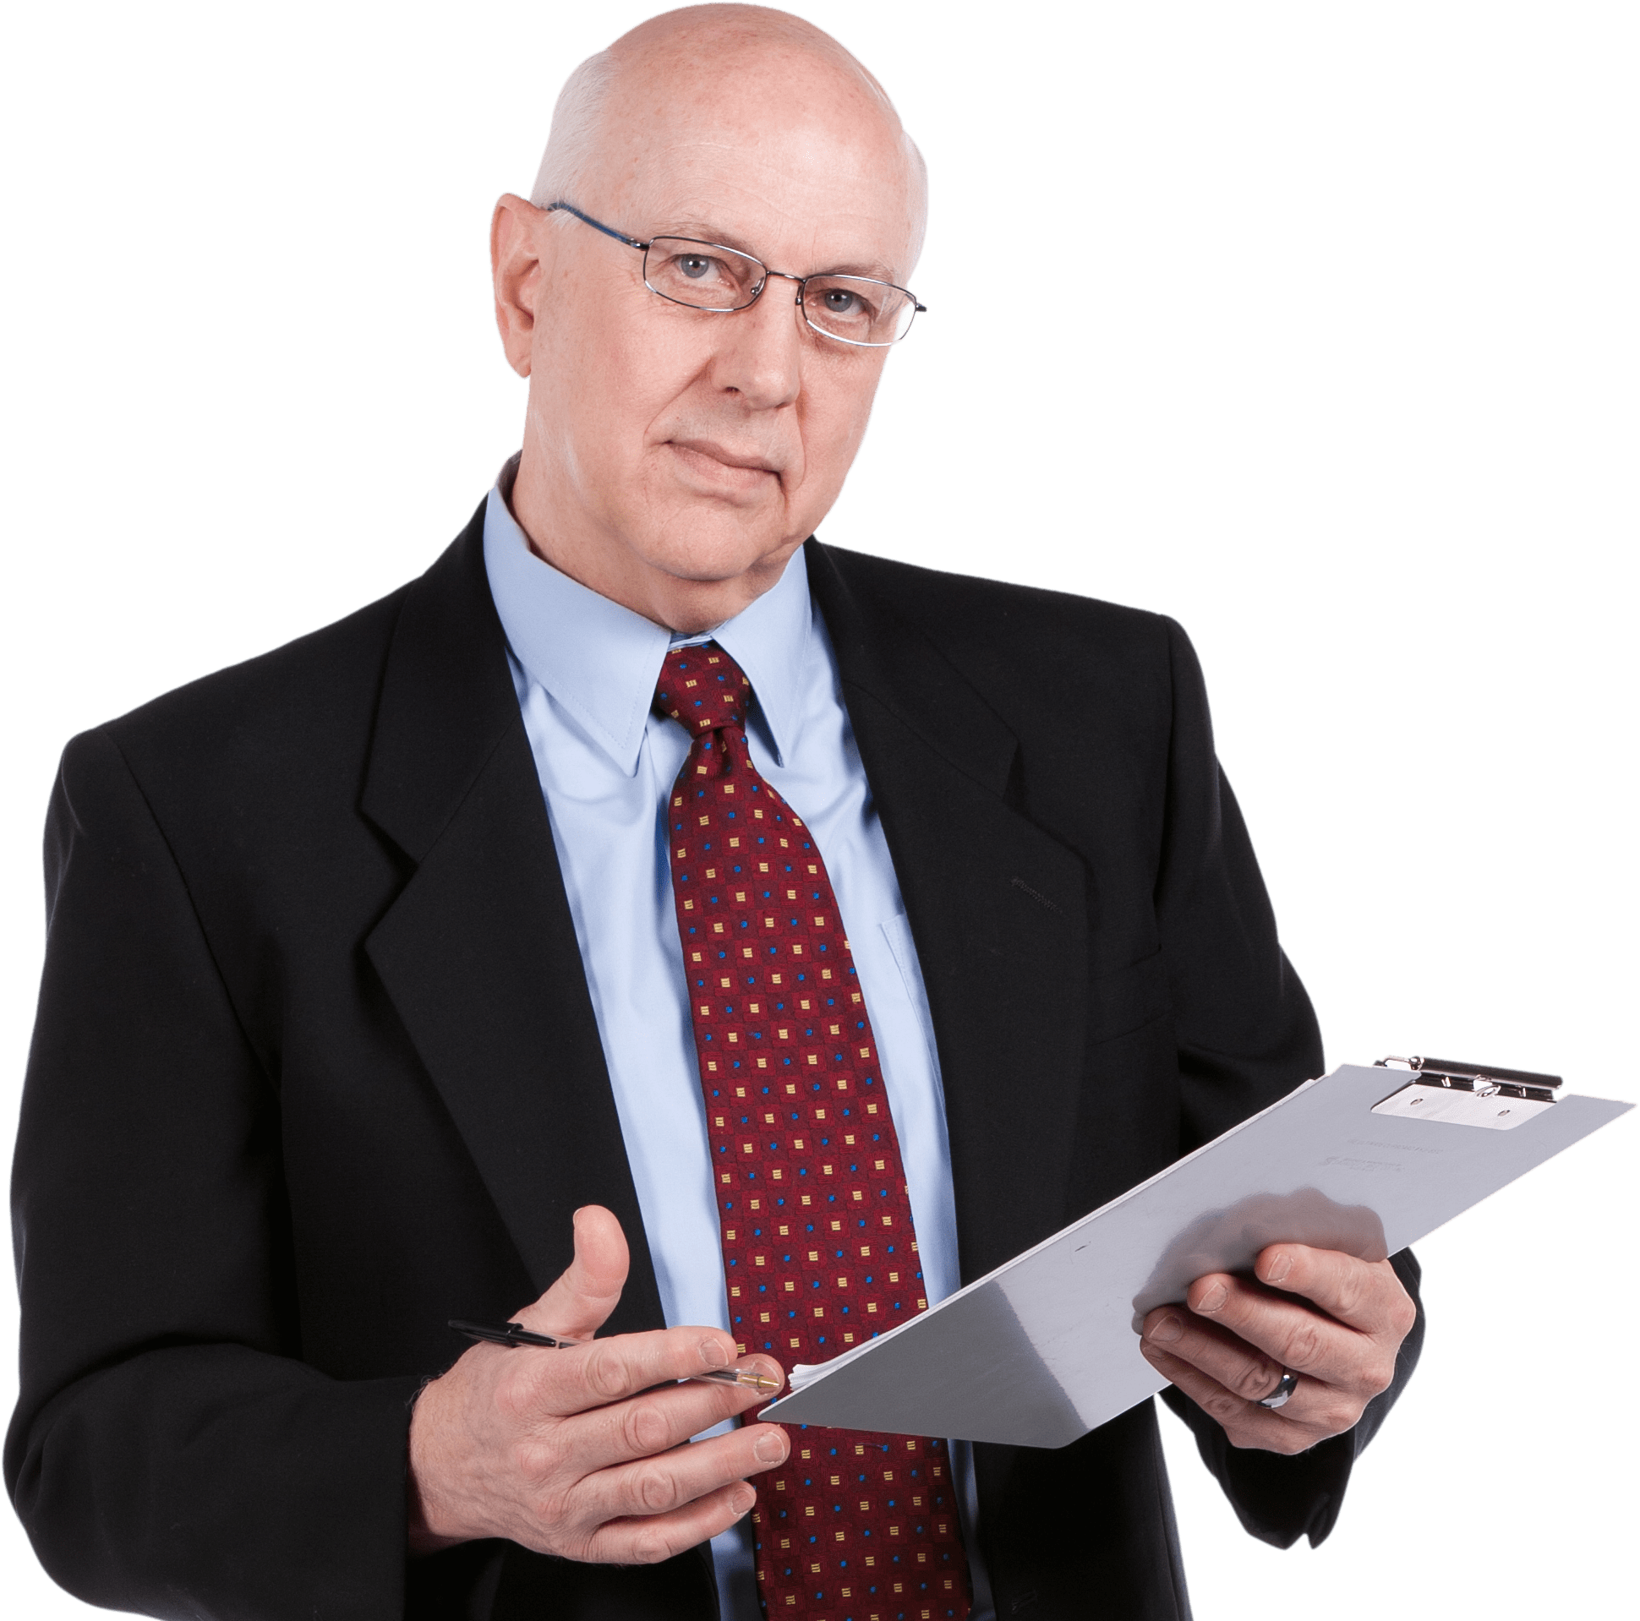
Problem Statement
Long Physical forms for the registration.
Highly Prone to Inaccuracy and very time inefficient.
Difficulty in handling Cards Information specially for Business Professionals, Startup founder, Event Organizers.

Slide 5

Proposed Solution
Utilize image processing for clarity.
Implement OCR for text extraction.
Validate extracted data for accuracy.
Design user-friendly interface.
Integrate with databases.
Implement error handling.

Slide 6








Software Requirements
Programming Language: Python
Operating System: Windows
Front-end: Python Tkinter Library
IDE: PyCharm

Slide 7
System Architecture
User Interface
Upload Image
Image Processing
Save & Copy of Text in Excel
Export Extracted Data
Display Extracted Text from Image
This figure illustrates the proposed system architecture.

Slide 8
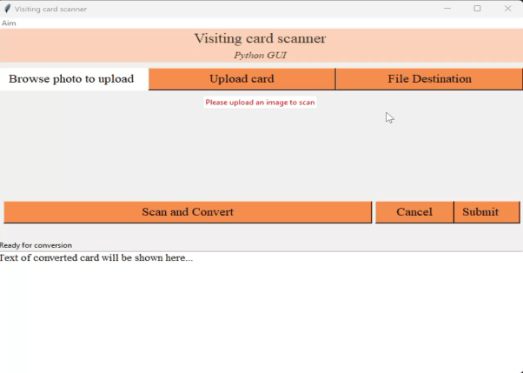
Demo Video
VIDEO-2024-05-01-09-49-25 1.mp4

Slide 9

Future Scope
Improve the OCR Accuracy
Support of Multilingual Visiting cards.
Mobile Application.
CRM integration.
Enhanced User Interface.

Slide 10

Conclusion
Aims to solve challenge of manual transcription of contact Information.
Utilize Advance Technologies like OCR.
User friendly interface.
Helps to organize information in Digitize & organize manner for the Business professional, Conferences, Administrative Professionals and Event Organizers.
Offer potential for future expansion.

Slide 11
Thank you!
Notes:
Reference
These are the references for this session.
11

